Slide 1
Logic and Proofs
Computer Science, Purdue University
Copyright McGraw Hill, Rosen, Discrete Mathematics and its Applications
Notes:
Once we represent facts in logic, propositional or predicate logic, we must have rules that we can use to construct new and valid statements. These rules are called rules of inference. In this lecture, we introduce rules of inference for propositional and predicate logic, and demonstrate their use in constructing valid inferences.

Slide 2
Logic and Proofs
Rules of Inference
We have the two premises:
“All men are mortal.”
“Socrates is a man.”
And the conclusion:
“Socrates is mortal.”
How do we get the conclusion from the premises?
Computer Science, Purdue University

Slide 3
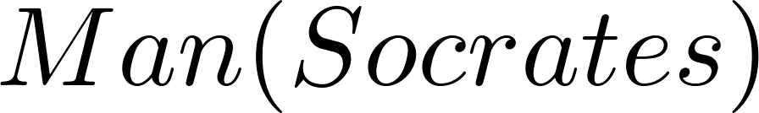
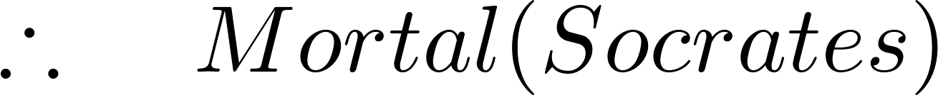
Logic and Proofs
Rules of Inference: The Argument
We can express the premises (above the line) and the conclusion (below the line) in predicate logic as an argument:
We will see shortly that this is a valid argument.
Computer Science, Purdue University

Slide 4
Logic and Proofs
Rules of Inference: Valid Arguments
We will show how to construct valid arguments in two stages; first for propositional logic and then for predicate logic. The rules of inference are the essential building block in the construction of valid arguments.
Propositional Logic
Inference Rules
Predicate Logic
Inference rules for propositional logic plus additional inference rules to handle variables and quantifiers.
Computer Science, Purdue University

Slide 5
Logic and Proofs
Arguments in Propositional Logic
An argument in propositional logic is a sequence of propositions. All but the final proposition are called premises. The last statement is the conclusion.
The argument is valid if the premises imply the conclusion. An argument form is an argument that is valid no matter what propositions are substituted into its propositional variables.
If the premises are p₁ ,p₂, …,p_{n} and the conclusion is q then
(p₁ ∧ p₂ ∧ … ∧ p_{n} ) → q is a tautology.
Inference rules are simple argument forms that will be used to construct more complex argument forms.
Computer Science, Purdue University

Slide 6
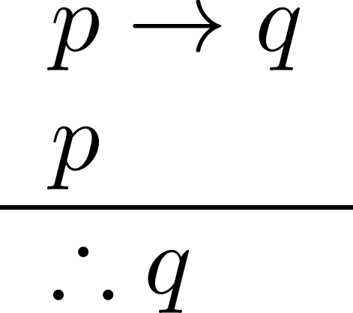
Logic and Proofs
Rules of Inference in Propositional Logic: Modus Ponens
Corresponding Tautology:
(p ∧ (p →q)) → q
Example:
Let p be “It is snowing.”
Let q be “I will study discrete math.”
“If it is snowing, then I will study discrete math.”
“It is snowing.”
“Therefore , I will study discrete math.”
Computer Science, Purdue University

Slide 7
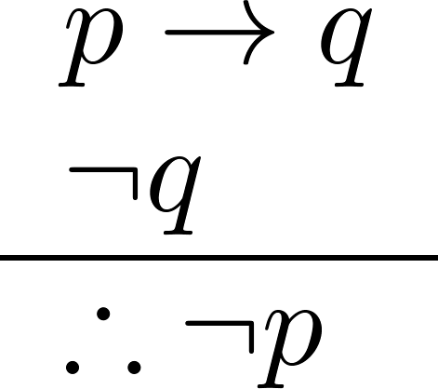
Logic and Proofs
Rules of Inference in Propositional Logic: Modus Tollens
Corresponding Tautology:
(¬q∧(p →q))→¬p
Example:
Let p be “it is snowing.”
Let q be “I will study discrete math.”
“If it is snowing, then I will study discrete math.”
“I will not study discrete math.”
“Therefore , it is not snowing.”
Computer Science, Purdue University

Slide 8
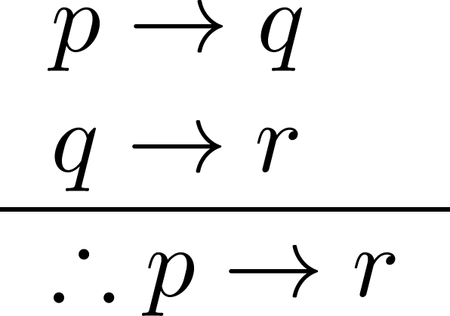
Logic and Proofs
Rules of Inference in Propositional Logic: Hypothetical Syllogism
Corresponding Tautology:
((p →q) ∧ (q→r))→(p→ r)
Example:
Let p be “it snows.”
Let q be “I will study discrete math.”
Let r be “I will get an A.”
“If it snows, then I will study discrete math.”
“If I study discrete math, I will get an A.”
“Therefore , If it snows, I will get an A.”
Computer Science, Purdue University

Slide 9
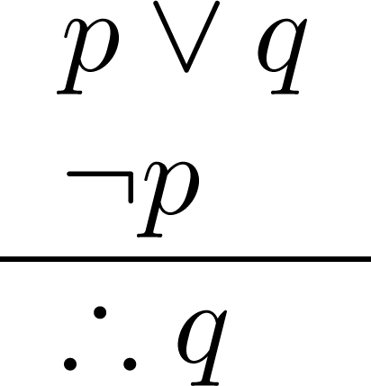
Logic and Proofs
Rules of Inference in Propositional Logic: Disjunctive Syllogism
Corresponding Tautology:
(¬p∧(p ∨q))→q
Example:
Let p be “I will study discrete math.”
Let q be “I will study English literature.”
“I will study discrete math or I will study English literature.”
“I will not study discrete math.”
“Therefore , I will study English literature.”
Computer science, Purdue University

Slide 10
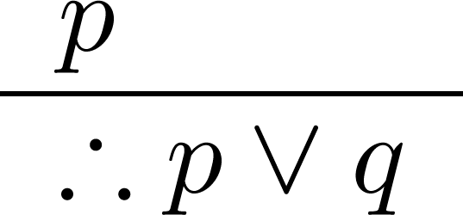
Logic and Proofs
Rules of Inference in Propositional Logic: Addition
Corresponding Tautology:
p →(p ∨q)
Example:
Let p be “I will study discrete math.”
Let q be “I will visit Las Vegas.”
“I will study discrete math.”
“Therefore, I will study discrete math or I will visit
Las Vegas.”
Computer Science, Purdue University

Slide 11
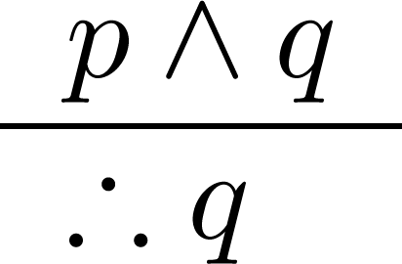
Logic and Proofs
Rules of Inference in Propositional Logic: Simplification
Corresponding Tautology:
(p∧q) →p
Example:
Let p be “I will study discrete math.”
Let q be “I will study English literature.”
“I will study discrete math and English literature”
“Therefore, I will study discrete math.”
Computer Science, Purdue University

Slide 12
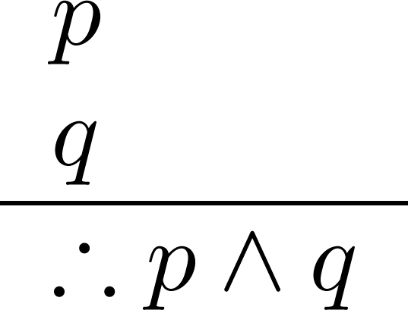
Logic and Proofs
Rules of Inference in Propositional Logic: Conjunction
Corresponding Tautology:
((p) ∧ (q)) →(p ∧ q)
Example:
Let p be “I will study discrete math.”
Let q be “I will study English literature.”
“I will study discrete math.”
“I will study English literature.”
“Therefore, I will study discrete math and I will study English literature.”
Computer Science, Purdue University

Slide 13
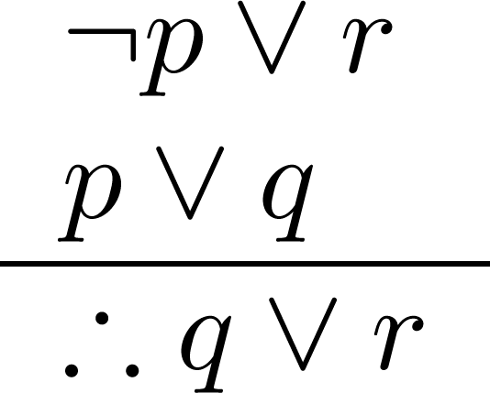
Logic and Proofs
Rules of Inference in Propositional Logic: Resolution
Corresponding Tautology:
((¬p ∨ r ) ∧ (p ∨ q)) →(q ∨ r)
Resolution plays an important role in AI and is used in Prolog.
Example:
Let p be “I will study discrete math.”
Let r be “I will study English literature.”
Let q be “I will study databases.”
“I will not study discrete math or I will study English literature.”
“I will study discrete math or I will study databases.”
“Therefore, I will study databases or I will study English literature.”
Computer Science, Purdue University

Slide 14
Logic and Proofs
Handling Quantified Statements
Valid arguments for quantified statements are a sequence of statements. Each statement is either a premise or follows from previous statements by rules of inference which include:
Rules of Inference for Propositional Logic
Rules of Inference for Quantified Statements
The rules of inference for quantified statements are introduced in the next several slides.
Computer Science, Purdue University

Slide 15
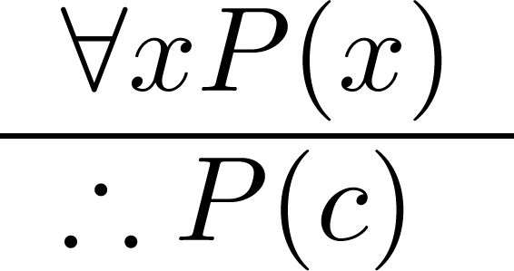
Logic and Proofs
Universal Instantiation
Example:
Our domain consists of all dogs and Fido is a dog.
“All dogs are cuddly.”
“Therefore, Fido is cuddly.”
Computer Science, Purdue University

Slide 16
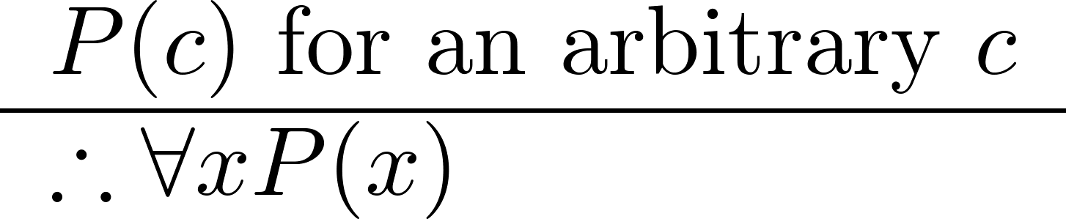
Logic and Proofs
Universal Generalization
Used often implicitly in Mathematical Proofs.
Computer Science, Purdue University

Slide 17
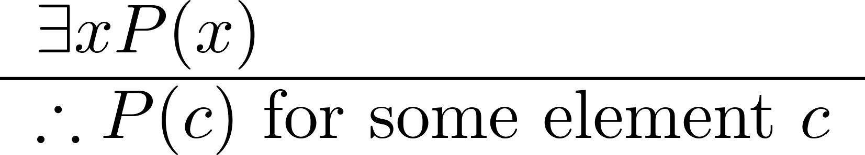
Logic and Proofs
Existential Instantiation
Example:
“There is someone who got an A in the course.”
“Let’s call her a and say that a got an A”
Computer science, Purdue University

Slide 18
Thank You

